Slide 1
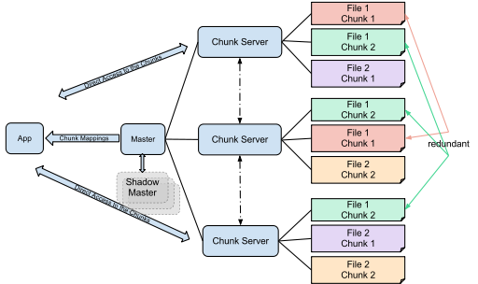
Organization of AWS EMR
S3
Long Term Storage
HDFS
Worker Nodes
Head node

